Slide 1
Department of Education's National Student Loan Data System (NSLDS) website
Use the following guide to access
the mandatory information needed for your Student Loan Repayment Program (SLRP).

Slide 2
Department of Education's National Student Loan Data System (NSLDS) website
The National Student Loan Data System (NSLDS) is the U.S. Department of Education's (DOE) central database for student aid.
NSLDS receives data from schools, guaranty agencies, the Direct Loan program, and other DOE programs. NSLDS Student Access provides a centralized, integrated view of Title IV loans and grants so that recipients of Title IV Aid can access and inquire about their Title IV loans and/or grant data.

Slide 3
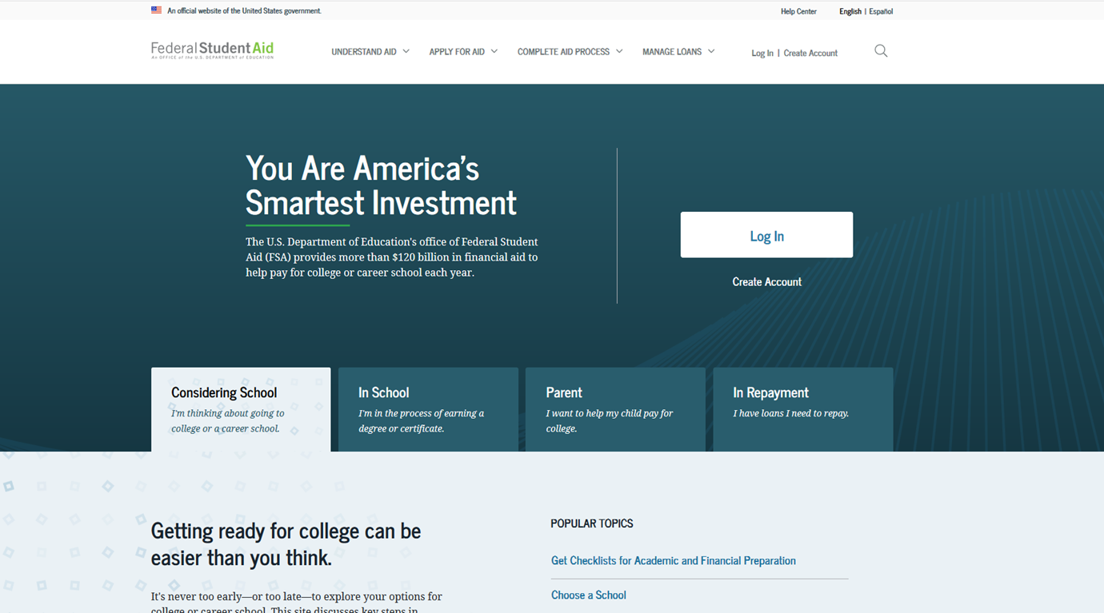


Department of Education's National Student Loan Data System (NSLDS) website
Use Google chrome or foxfire browser.
https://studentaid.gov

Slide 4
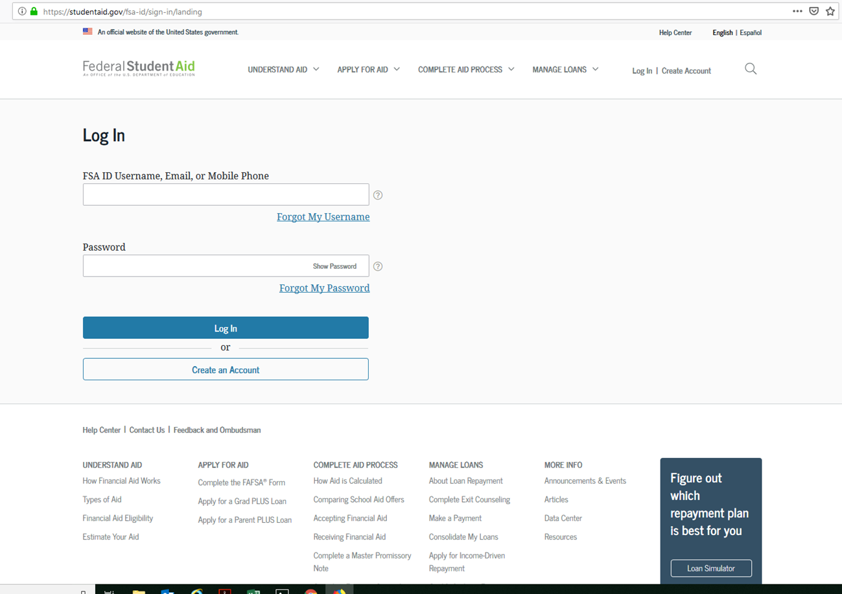
Department of Education's National Student Loan Data System (NSLDS) website

Slide 5
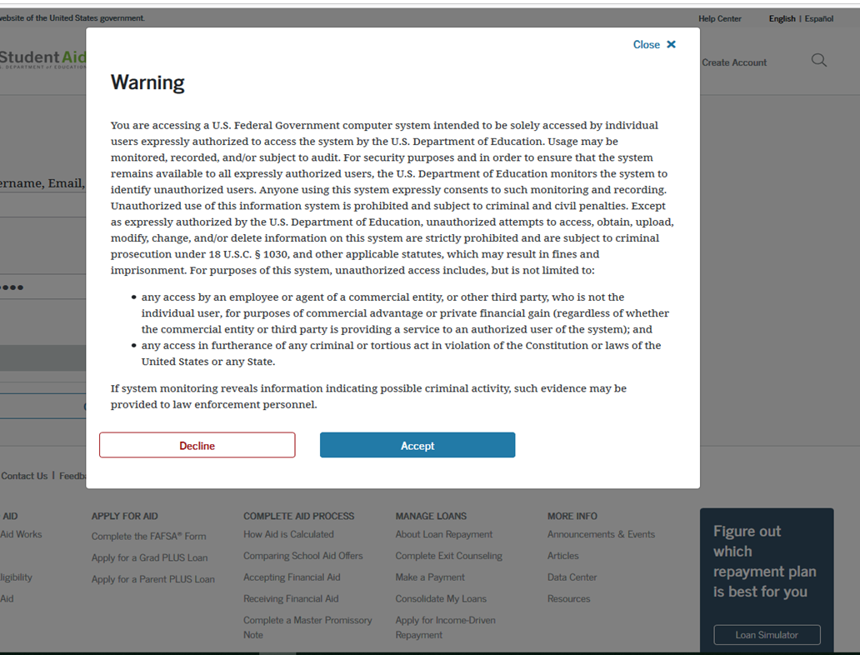

Department of Education's National Student Loan Data System (NSLDS) website
Click accept to take you to the dashboard

Slide 6
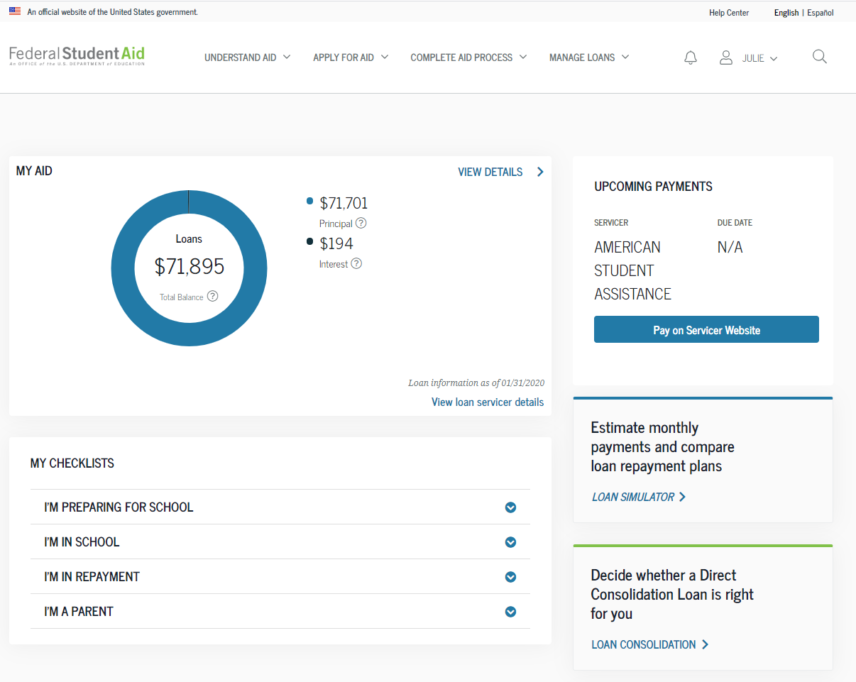
Department of Education's National Student Loan Data System (NSLDS) website
On the dashboard click view detail

Slide 7
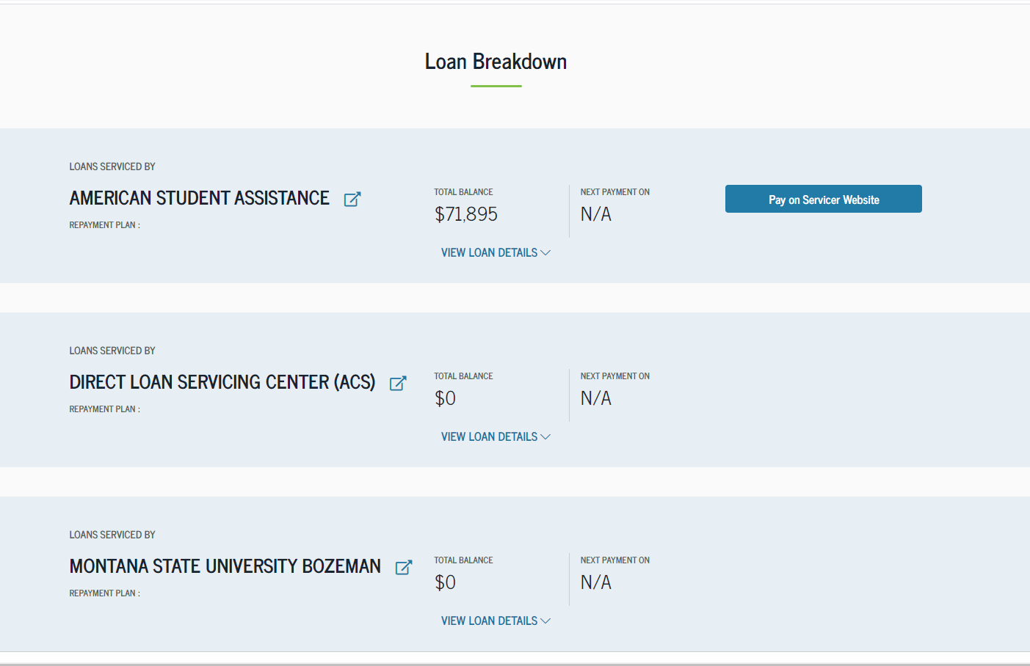

Department of Education's National Student Loan Data System (NSLDS) website
Scroll down to the loan breakdown an click view loan detail for each loan servicer

Slide 8
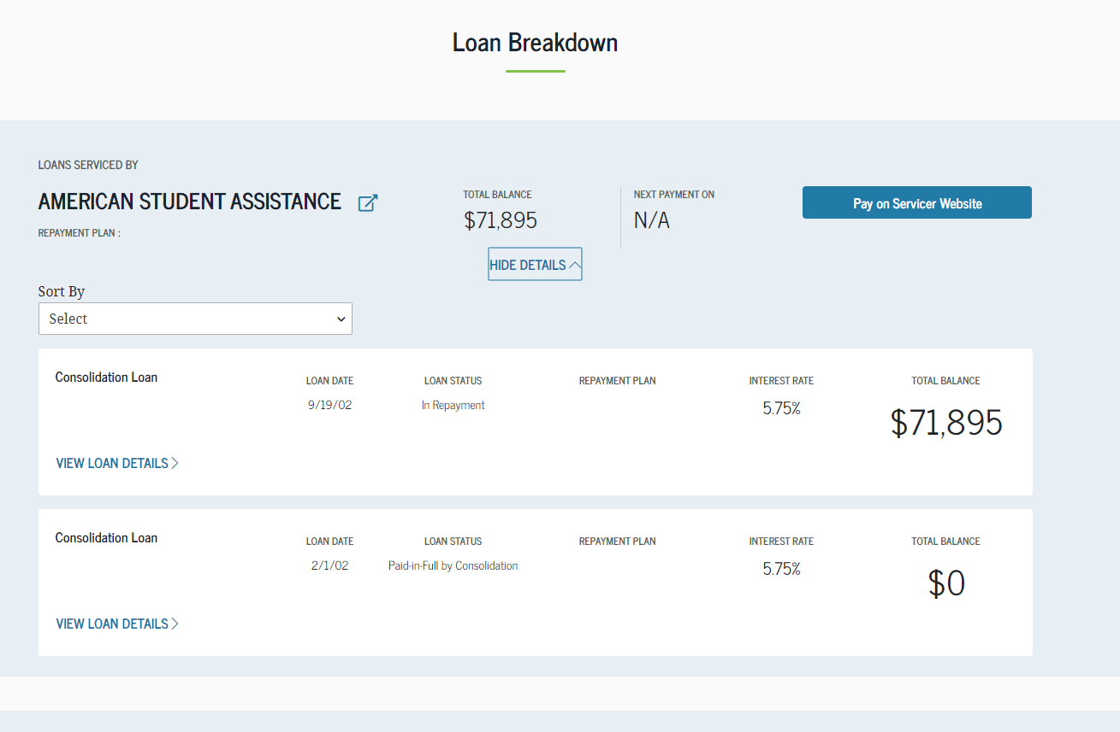
Department of Education's National Student Loan Data System (NSLDS) website
Once all loan servicers are open, print page by following the next slide

Slide 9

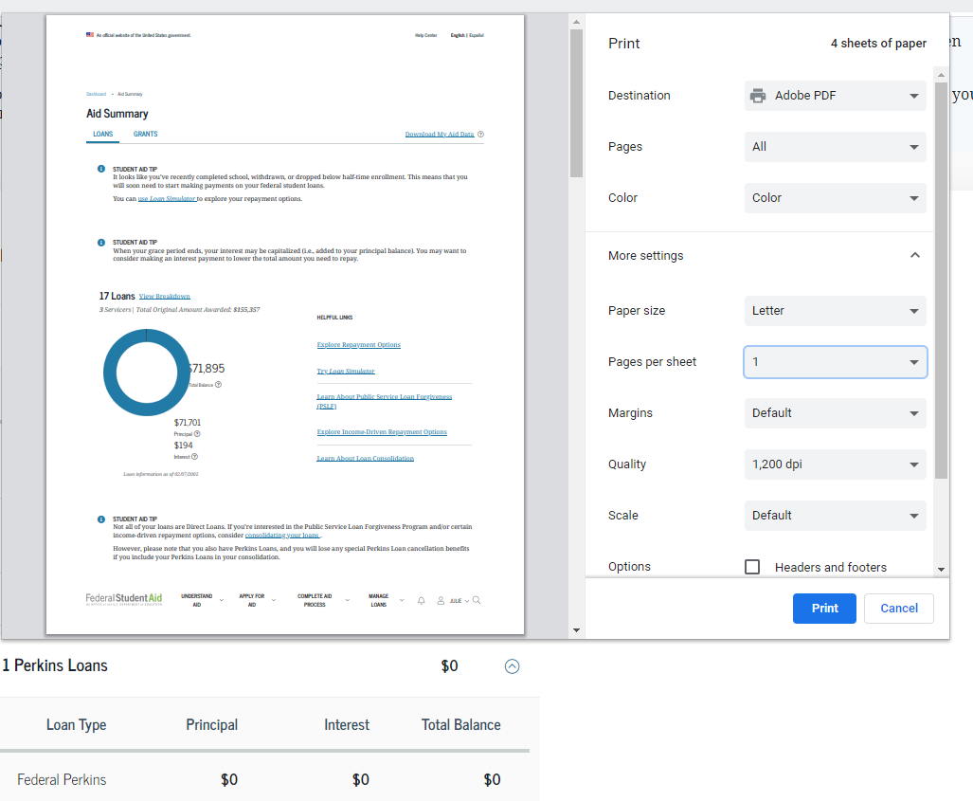

Department of Education's National Student Loan Data System (NSLDS) website
Click the three dots on the left side of the address bar and chose print
Print to adobe PDF make sure the header and footer option is unchecked

Slide 10
Department of Education's National Student Loan Data System (NSLDS) website
Click the view loan detail

Slide 11
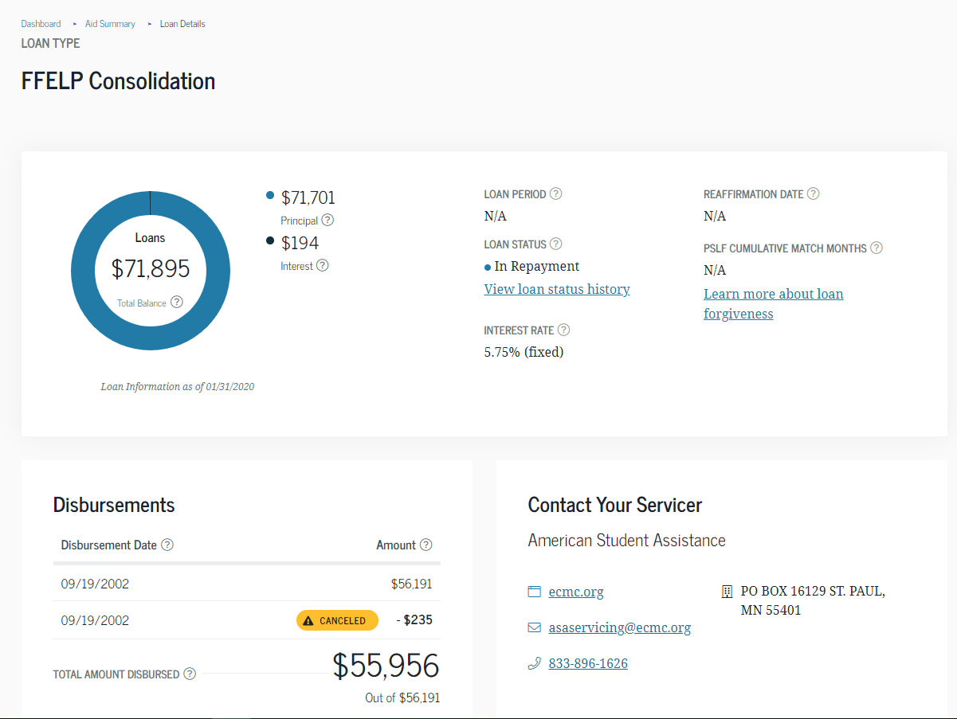
Department of Education's National Student Loan Data System (NSLDS) website

Slide 12
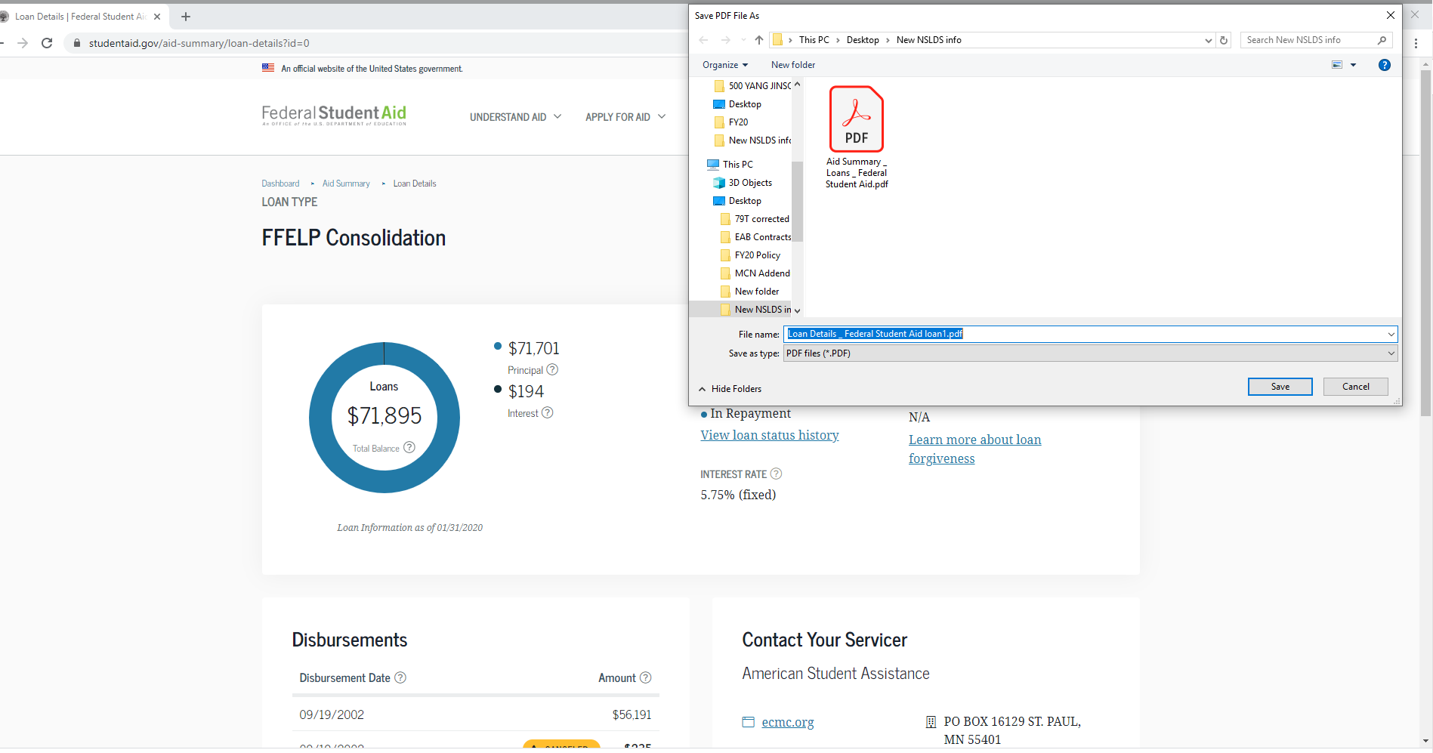

Department of Education's National Student Loan Data System (NSLDS) website

Slide 13

Department of Education's National Student Loan Data System (NSLDS) website
Click the view loan status history

Slide 14
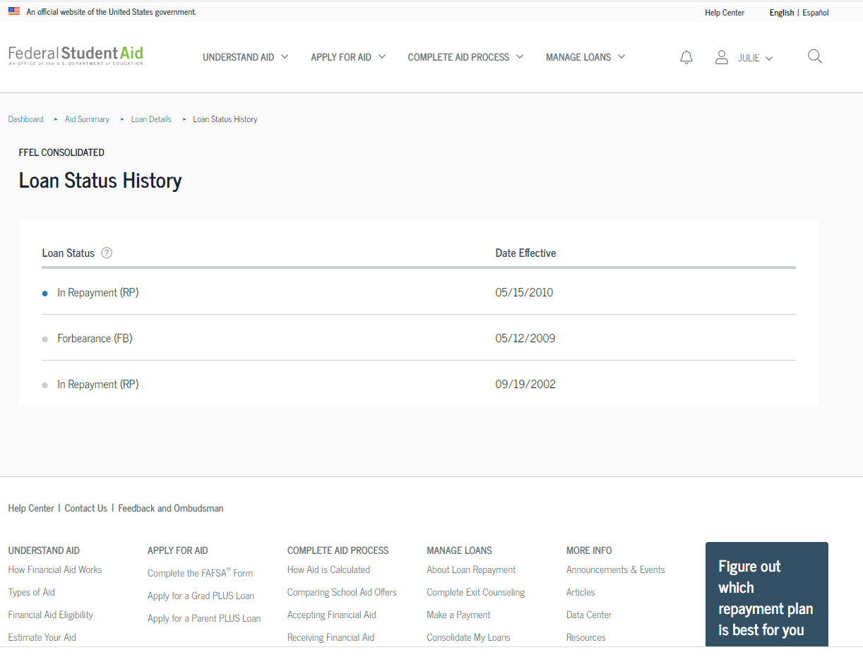
Department of Education's National Student Loan Data System (NSLDS) website

Slide 15
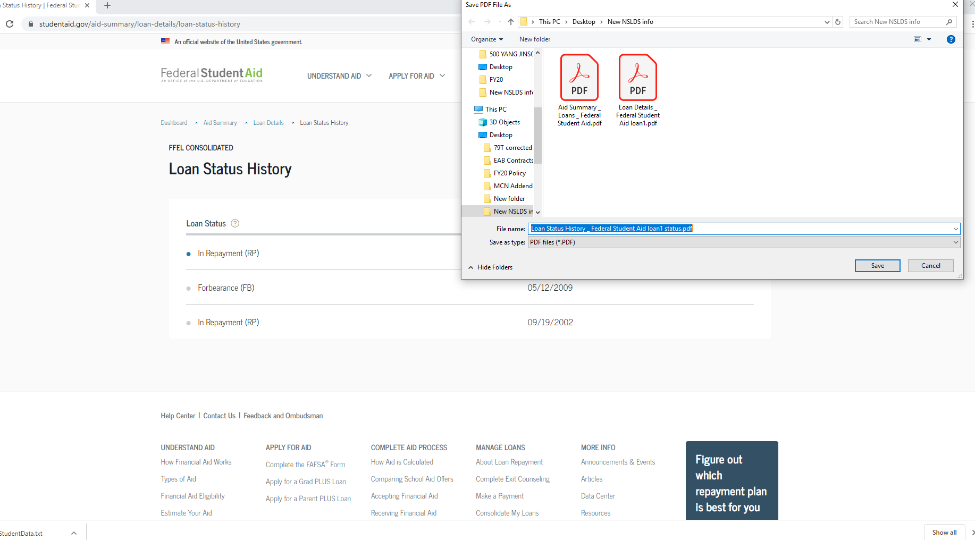
Department of Education's National Student Loan Data System (NSLDS) website
Print the loan status history as described in previous slide.
Repeat this process for all loans.

Slide 16
Department of Education's National Student Loan Data System (NSLDS) website
It is your responsibility to complete this action every year no more than 30 days prior to your SLRP payment due date.
In accordance with Army National Guard policy, a SLRP payment cannot be made with out the NSLDS printouts.
Turn in the pages you printed out to the appropriate Full Time unit personnel to ensure your payment is not delayed.

Slide 17
Department of Education's National Student Loan Data System (NSLDS) website
For more information about your SLRP program, contact your State Education & Incentives POC.

